Slide 1
Final Project Course Enrollment System Overview
Alex Nieves
CST499: Capstone for Computer Software Technology
Amr Elchouemi
10/31/2022

Slide 2

Objectives
Understand:
The Purpose of this Project
Basic Elements of the SRS
UML Models that were used
Design of the basic pages
Features of the System
PHP Source Code

Slide 3

SRS Document
Project Purpose
Create a functional and user-friendly course enrollment system
Technology
XAMPP, HTML, CSS, VSCode, MySQL, PHP
Requirements
Create an account, login, and logout
View course schedule
Add a course
Add student to waitlist when course is full
Drop a course
Notification when added to a course from waitlist

Slide 4
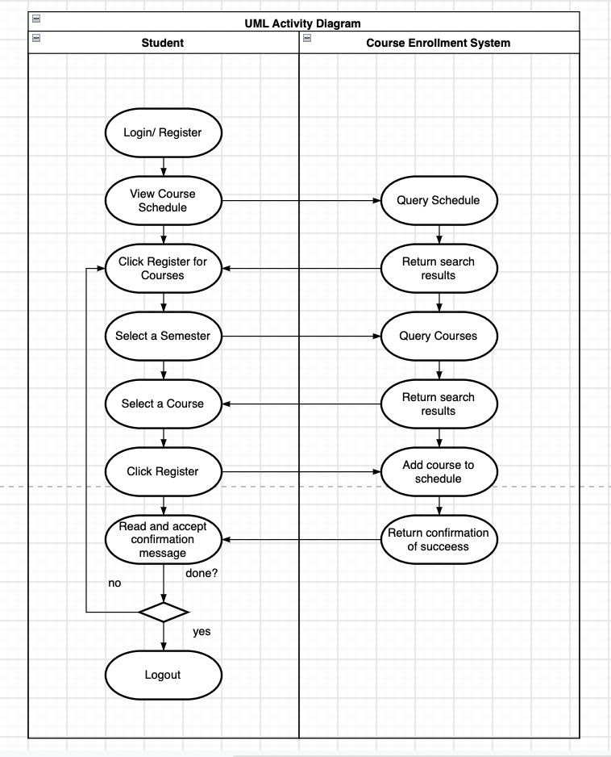
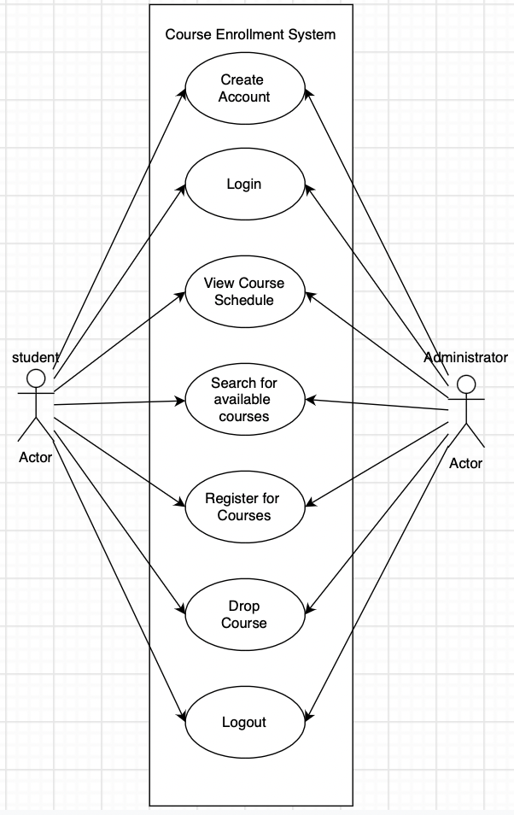
UML Models
Use Case
Activity
Sequence

Slide 5
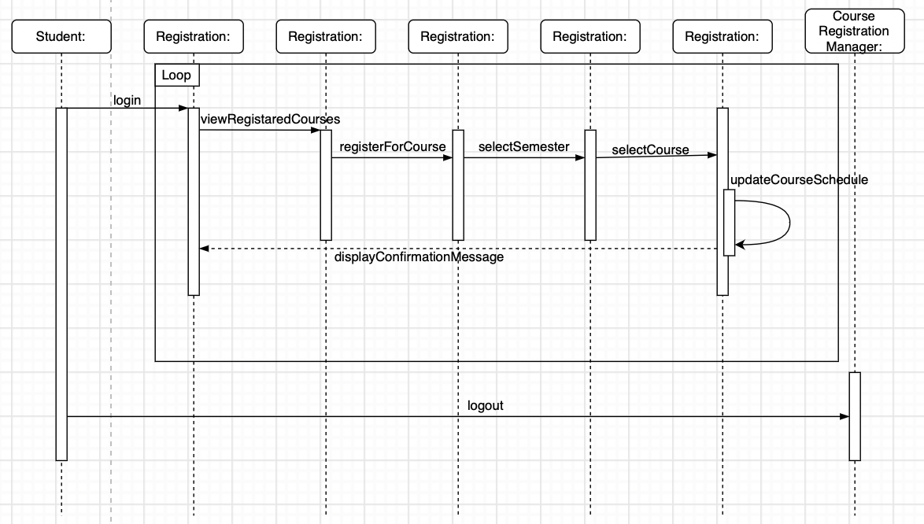
UML Models
Use Case
Activity
Sequence

Slide 6
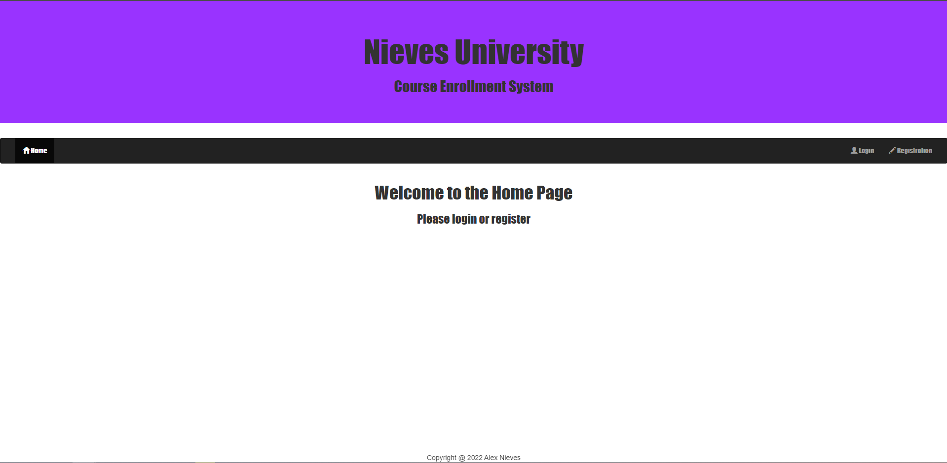
Page Design: Landing Page

Slide 7
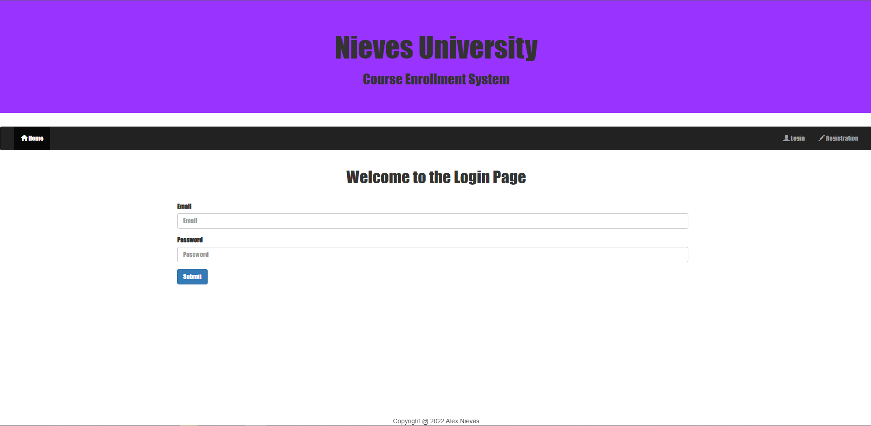
Page Design: Login Page

Slide 8
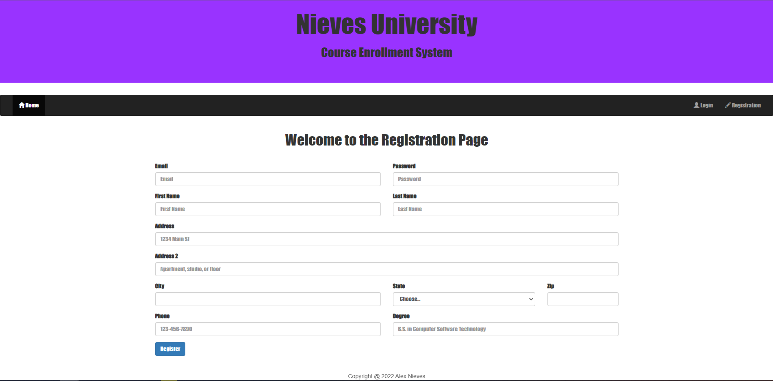
Page Design: Registration Page

Slide 9
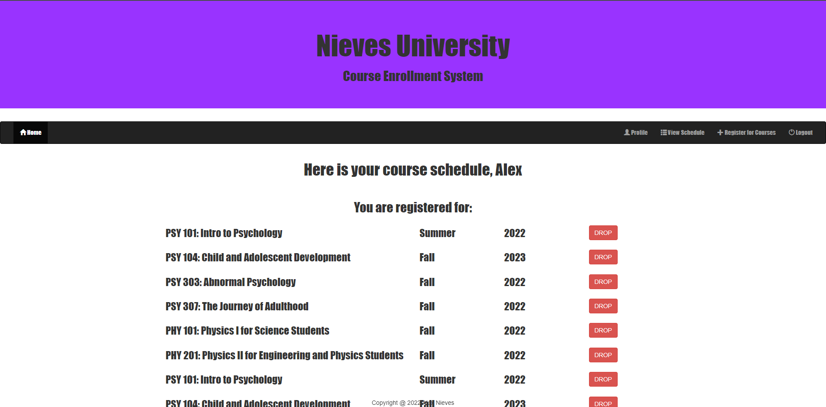
Page Design: View Course Page

Slide 10
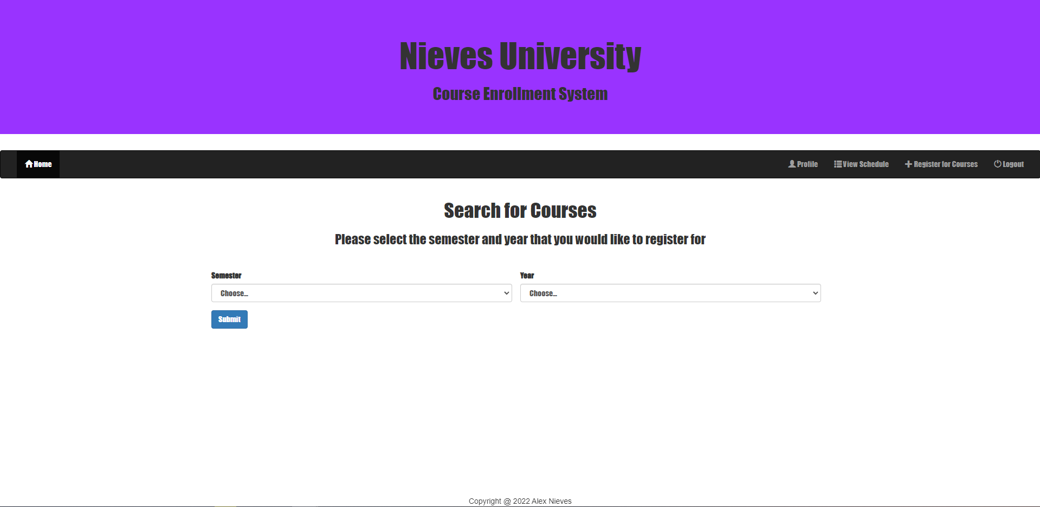
Page Design: Add Course Page

Slide 11
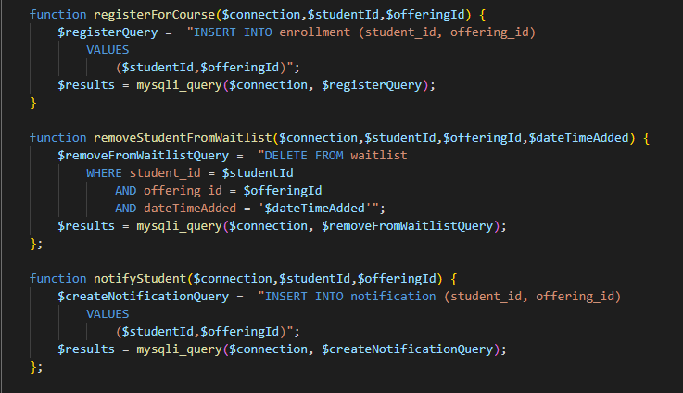
PHP Source Code
Functions
Modular
DRY

Slide 12




Thank you
By: Alex Nieves

